Slide 1

FAST National University of Computer and Emerging Sciences, Islamabad
Civics and Community Engagement
by
Ms. Iqra Nazar

Slide 2

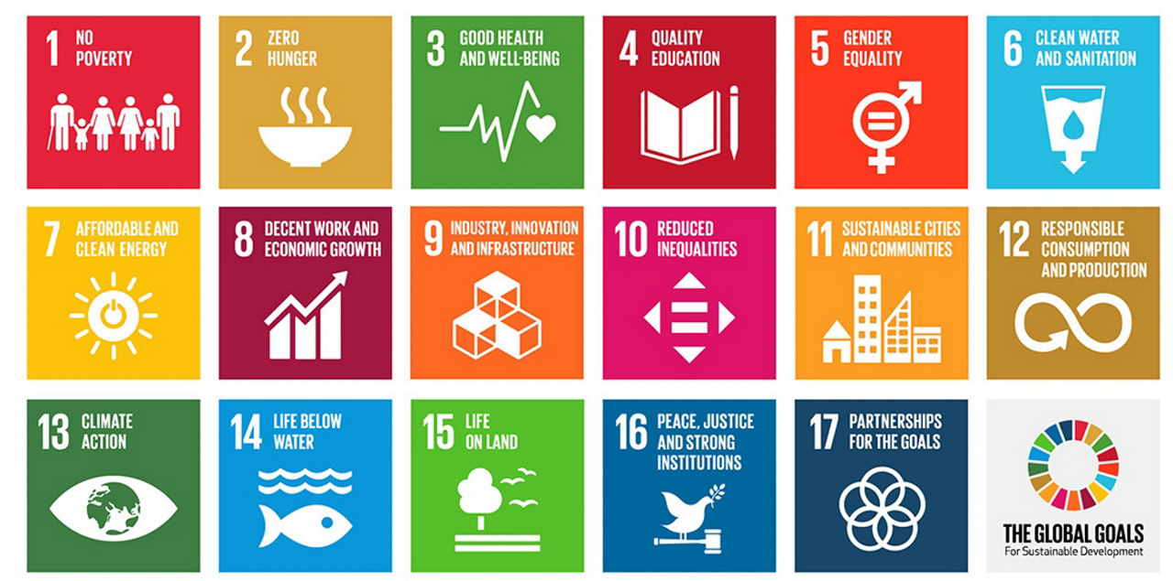

Slide 3

The 17 Sustainable Development Goals (SDGs)
The 17 Sustainable Development Goals (SDGs) are a set of interconnected goals adopted by the United Nations in 2015.
The SDGs are universal, meaning they apply to all countries.
They are also integrated, meaning that they are interconnected and cannot be achieved in isolation.

Slide 4
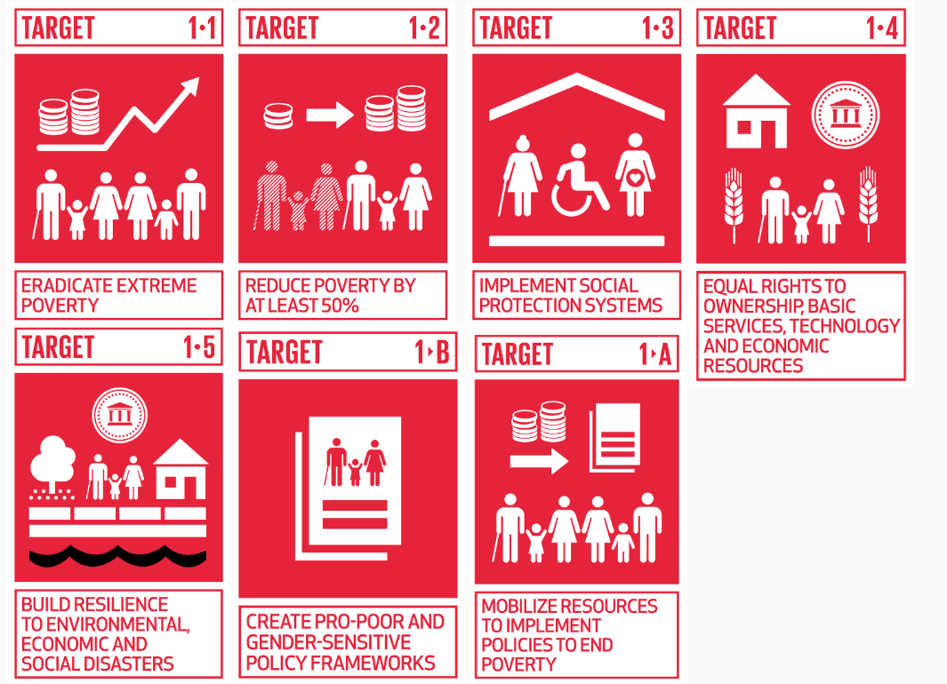
SDG 1: No Poverty

Slide 5
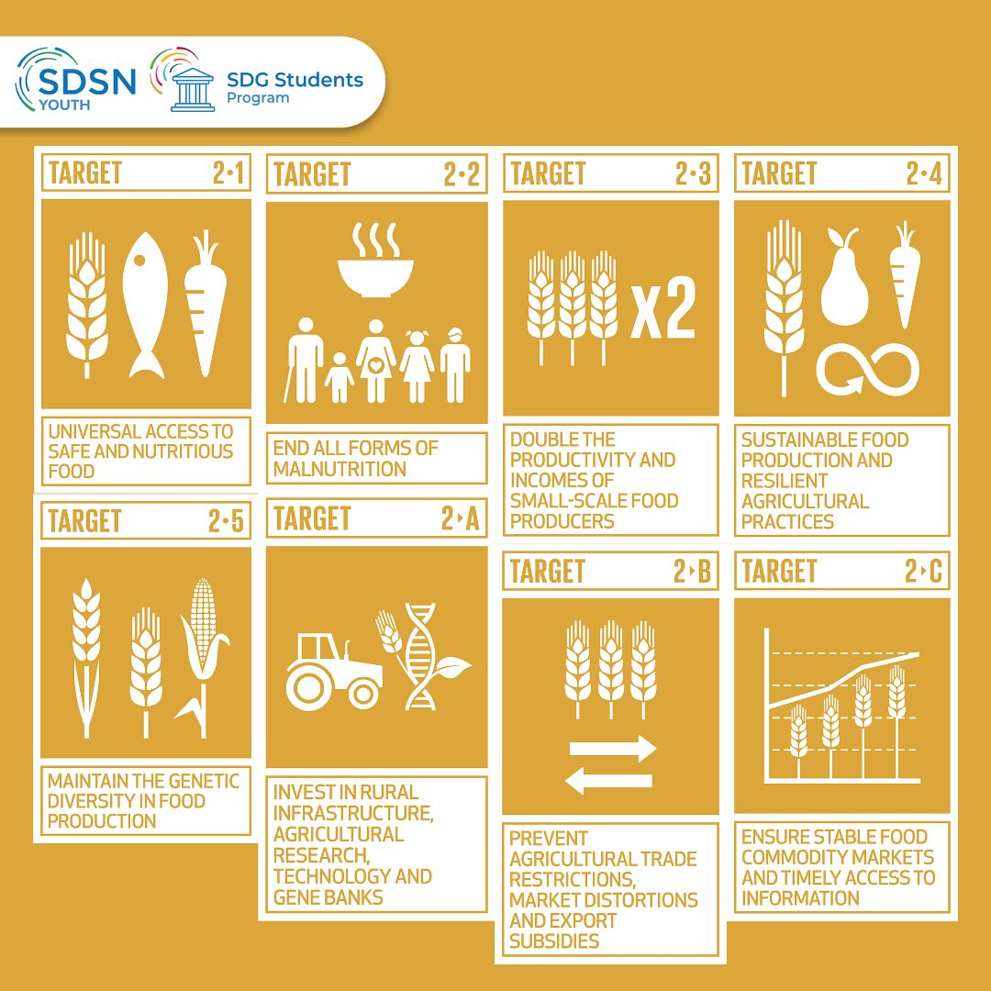
SDG 2: Zero Hunger

Slide 6
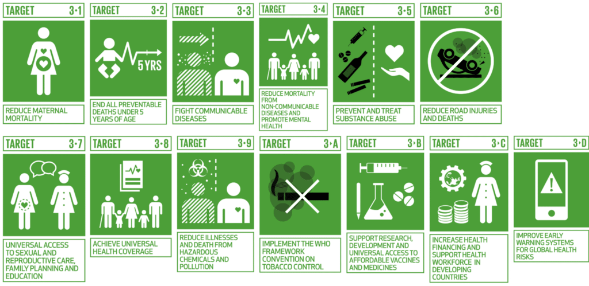
SDG 3: Good Health and Wellbeing

Slide 7
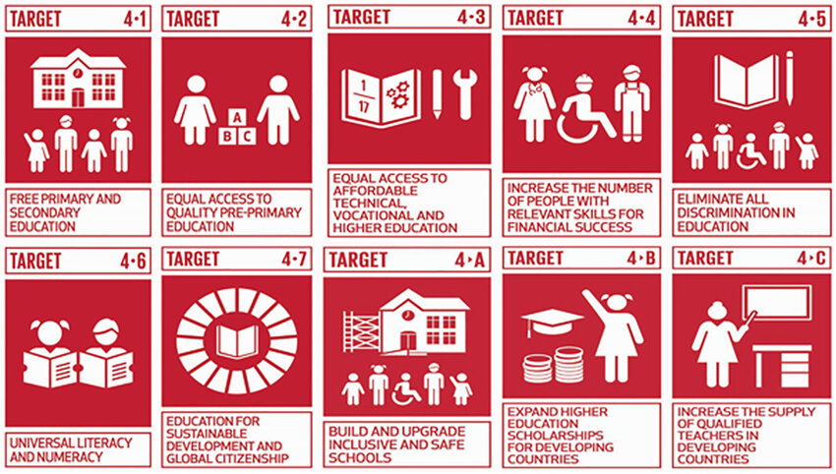
SDG 4: Quality Education

Slide 8
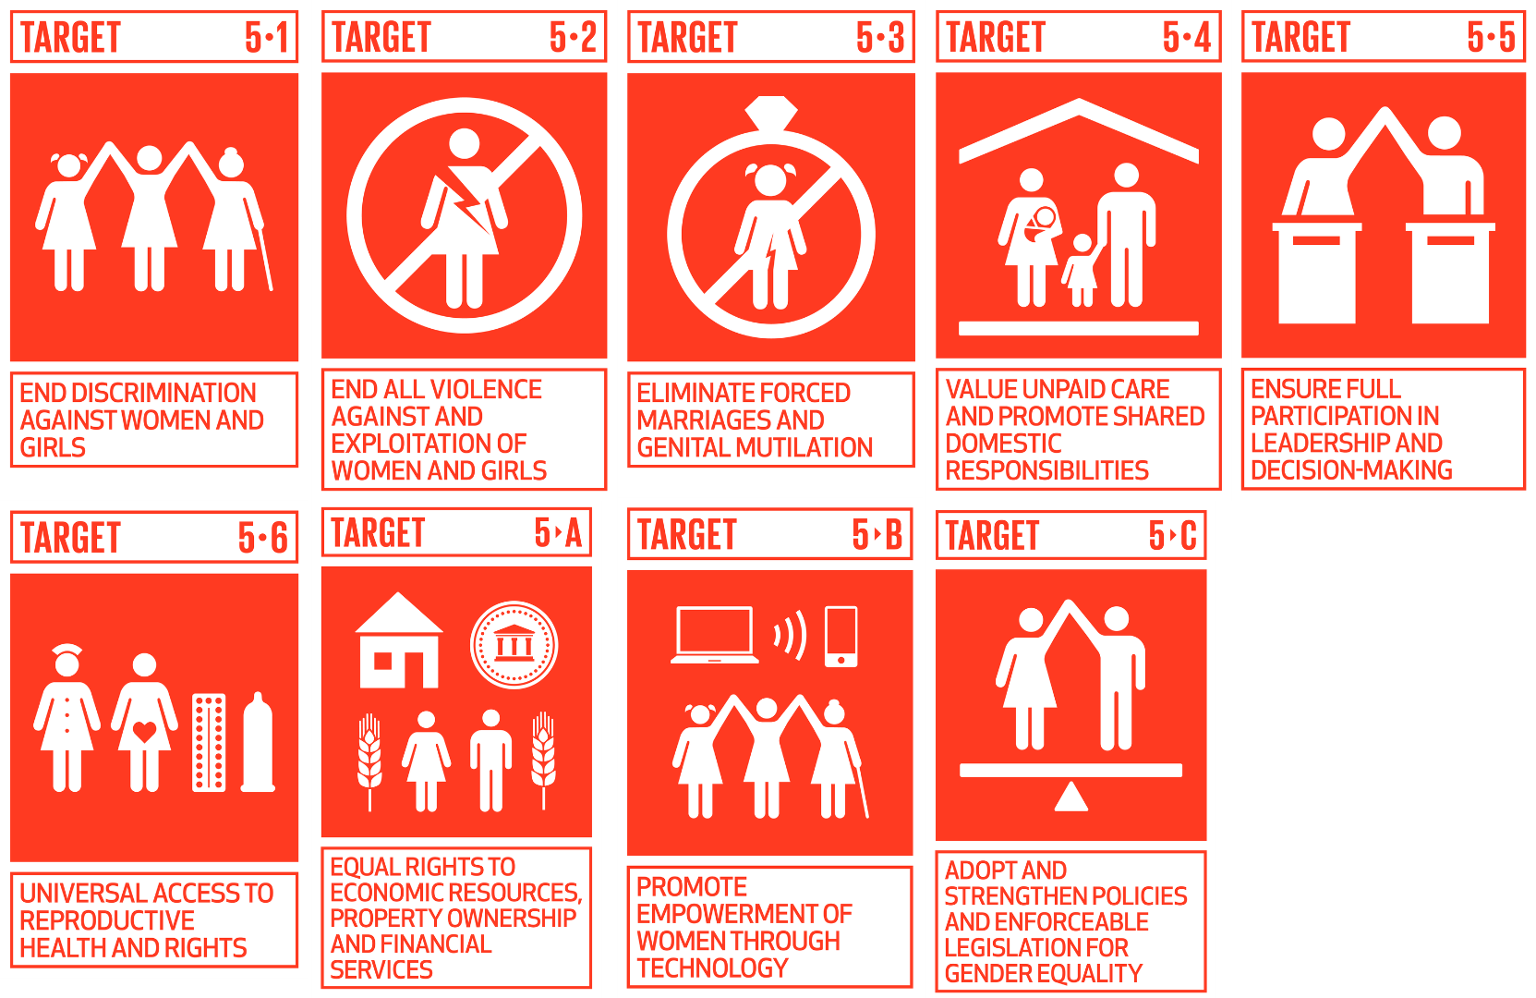
SDG 5: Gender Equality

Slide 9
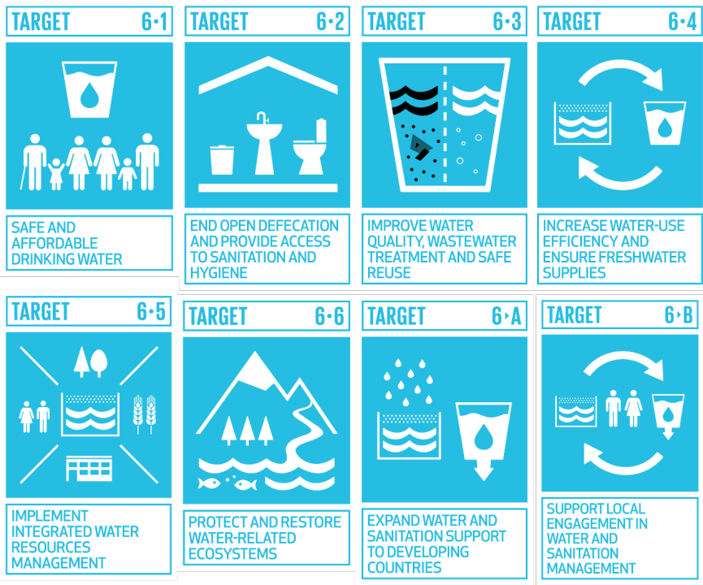
SDG 6: Clean Water and Sanitation

Slide 10
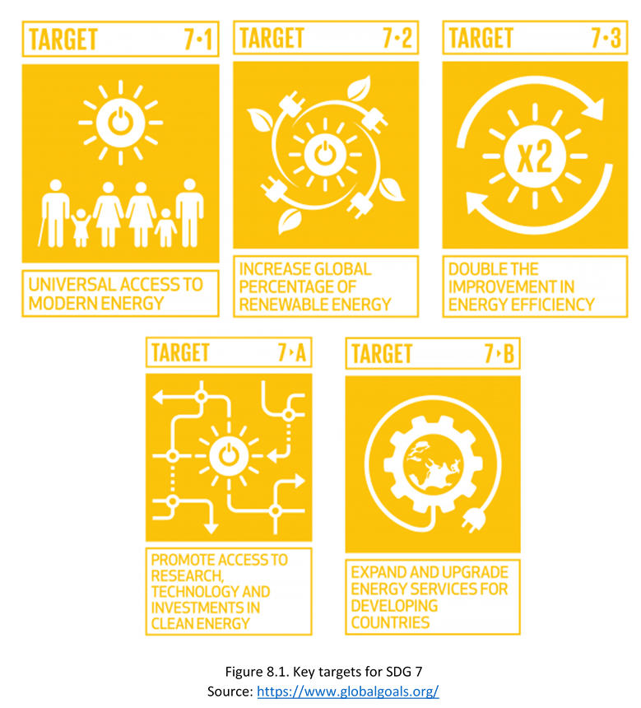
Goal 7: Affordable and Clean Energy

Slide 11
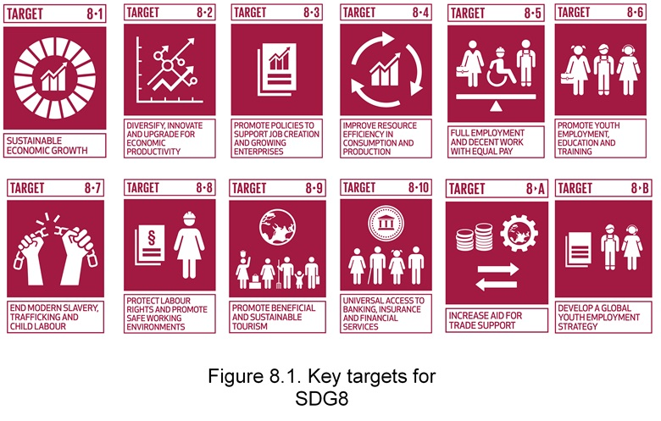
Goal 8: Decent Work and Economic Growth

Slide 12
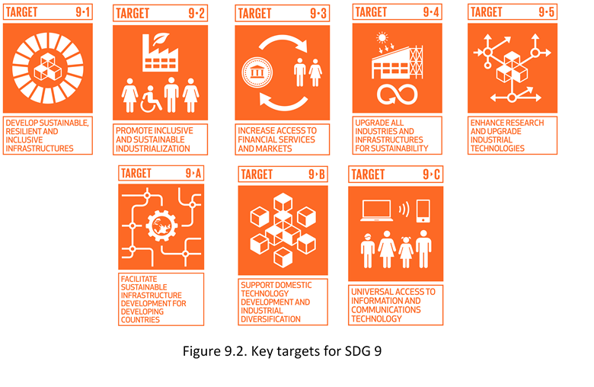
Goal 9: Industry, Innovation, and Infrastructure

Slide 13
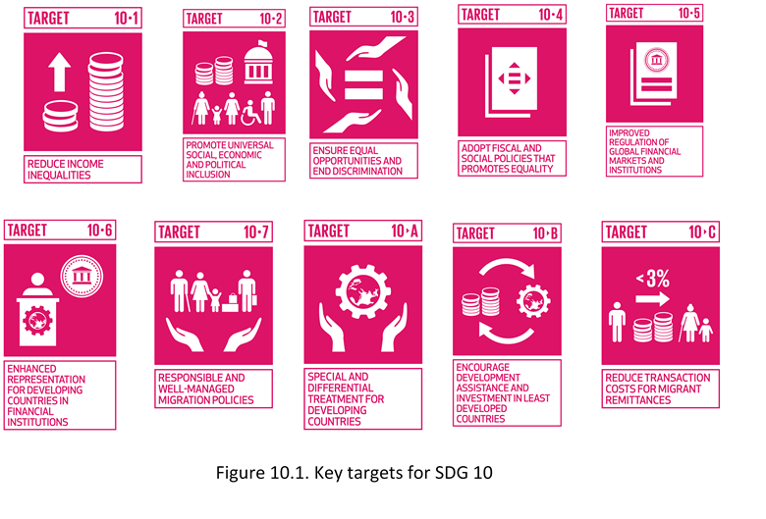
Goal 10: Reduced Inequalities

Slide 14
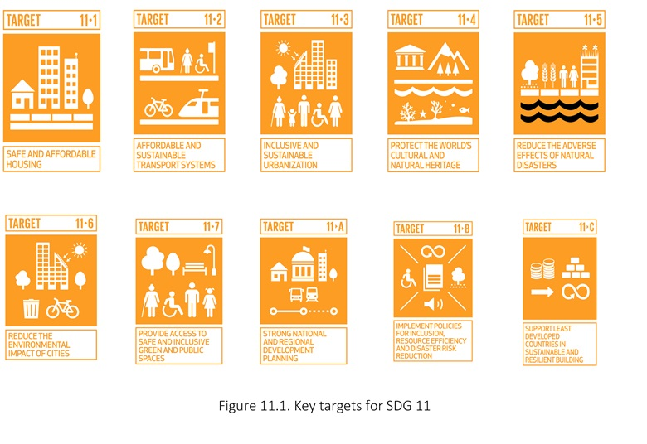
Goal 11: Sustainable Cities and Communities

Slide 15
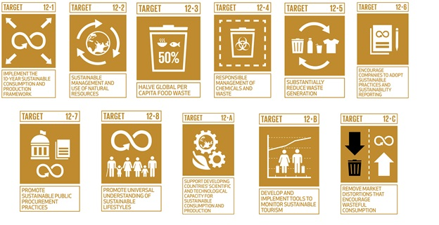
Goal 12: Responsible Consumption and Production

Slide 16
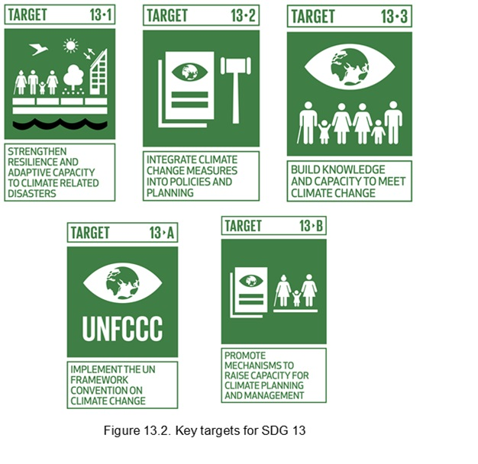
Goal 13: Climate Action

Slide 17
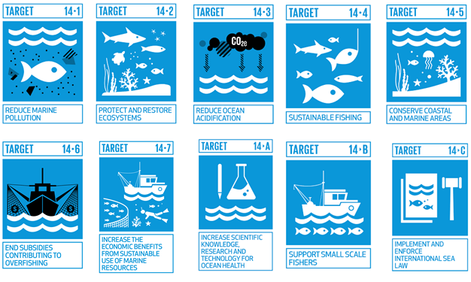
Goal 14: Life Below Water

Slide 18
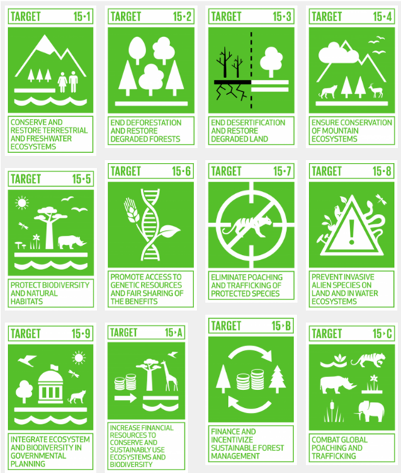
Goal 15: Life on Land

Slide 19
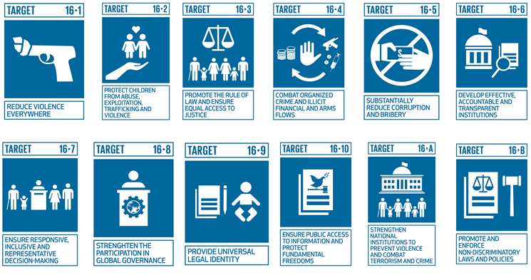
Goal 16: Peace, Justice & Strong Institutions

Slide 20
Goal 17: Partnerships for the Goals
Targets: 19
Main Focus
Finance (Domestic resource mobilization, ODA, Loan for sustainable development)
Technology (Cooperation, Transfer, and Operationalization)
Capacity building
Trade (Free trade, Multilateral trade)
Systematic Issues (Macroeconomic stability, Countries level policies)
Multi-Stakeholder Partnerships (Global & Local partnerships for sustainable development)
Data, Monitoring, and Accountability (Increase availability of disaggregated data &
development of progress measures)

Slide 21
SDG 1: Example of Student Initiatives
Volunteer with NGOs or community organizations that focus on poverty alleviation, such as food banks, shelters, or community outreach programs.
Organize or participate in awareness campaigns, workshops, or discussions on poverty issues and SDG 1
Undertake research projects or write papers on poverty-related topics, such as the effectiveness of social protection systems or the impact of economic growth on poverty reduction.
Organize or take part in fundraising events, such as charity runs, auctions, or online campaigns, to support poverty alleviation programs.
Initiate or join community service projects, such as tutoring disadvantaged students, creating care packages for low-income families, or organizing skills workshops.

Slide 22
SDG 2: Examples of Student Initiatives
Assist at food banks or community gardens by helping with food distribution, gardening, or organizing community events.
Create and run campaigns or workshops to raise awareness about nutrition, food security, and sustainable agriculture in your school or community.
Initiate a garden project at your school or community center to grow fruits, vegetables, and herbs.
Campaign for sustainable food practices in your school cafeteria or community, such as reducing food waste, supporting local farmers, or promoting plant-based options.
Engage in research projects or surveys that assess local food security issues, nutritional needs, or agricultural practices.

Slide 23
Conclusion
Achieving the 17 SDGs requires a collective effort from governments, businesses, civil society, and individuals. By working together, we can create a more sustainable and equitable world for all. It is essential to prioritize collaboration, innovation, and inclusive development to address the challenges and achieve the transformative goals for a better future.

Slide 24
Class Activity
Choose one SDG and analyze Pakistan’s current progress on it.
Discuss its key challenges, provide relevant data or case studies, and propose actionable recommendations to improve outcomes.
Present your findings to the class in 5-7 minutes.

Slide 25
Small pointer
Each group will research and discuss:
The current state of their assigned SDG in Pakistan.
Progress made so far (using data and reports).
Key challenges and barriers.
Examples of initiatives or policies addressing the SDG.

Slide 26
Open Discussion between all Groups
Which SDG seems most challenging for Pakistan? Why?
What role can students or local communities play in advancing these goals?
How can technology and innovation help achieve SDGs in Pakistan?

